Slide 1
Using Machine Learning for Enhanced Underground Carbon Storage Research
Sepideh Alimohammadi
July 30th, 2024

Slide 2
Outline
Introduction and Statement of Problem
Data Gathering and MD
Data Pre-processing and Cleaning
Independent Variable Selection, Significance Test and EDA
Initial ML Method
Hyperparameter Tuning, For-Loop, Optuna, PSO
Comparison Between MLs
Summary, Challenges, and Future Work

Slide 3
Introduction
Background:
Climate Change Mitigation: Underground carbon storage is a vital technique for reducing atmospheric CO2 levels, which helps mitigate climate change.
Challenges: Accurate prediction of carbon/water density in underground reservoirs is complex due to varying temperature, pressure, and energy conditions.
Machine Learning Approach:
Why Machine Learning: Traditional methods (thermodynamics or experimental) struggle with the non-linear relationships between variables. ML can handle these complexities and provide more precise models.
Key Variables:
Temperature (T): Influences the physical state and reactions of carbon compounds.
Pressure (P): Affects the solubility and density of carbon.
Energy: Relates to the phase transitions and stability of carbon under different conditions.
Project Goals:
Develop robust ML models to predict carbon/water density.
Use predictions to optimize storage conditions and enhance storage safety and efficiency.
Contribute to the broader effort of sustainable climate solutions through advanced technological integration.
Significance:
Innovation in Carbon Storage: Using ML models can lead to better understanding and management of underground storage sites.
Environmental Impact: Improved storage techniques can significantly reduce atmospheric CO2, aiding in the fight against global warming.

Slide 4
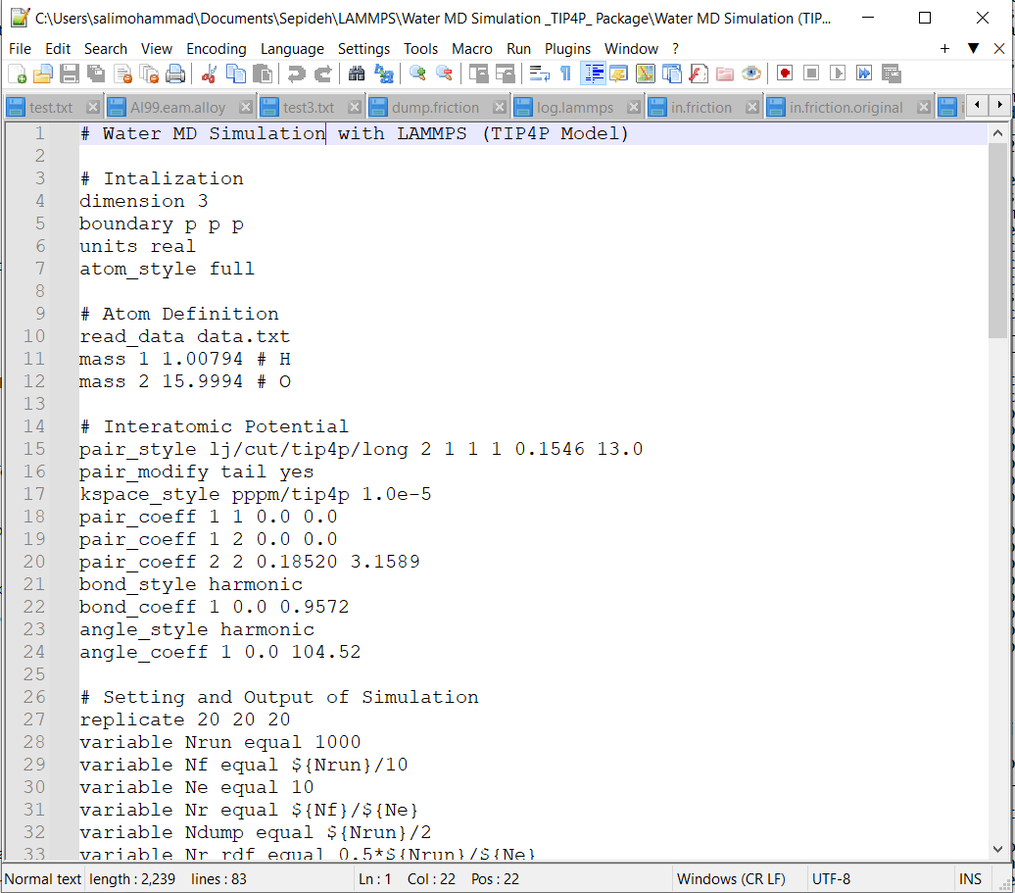
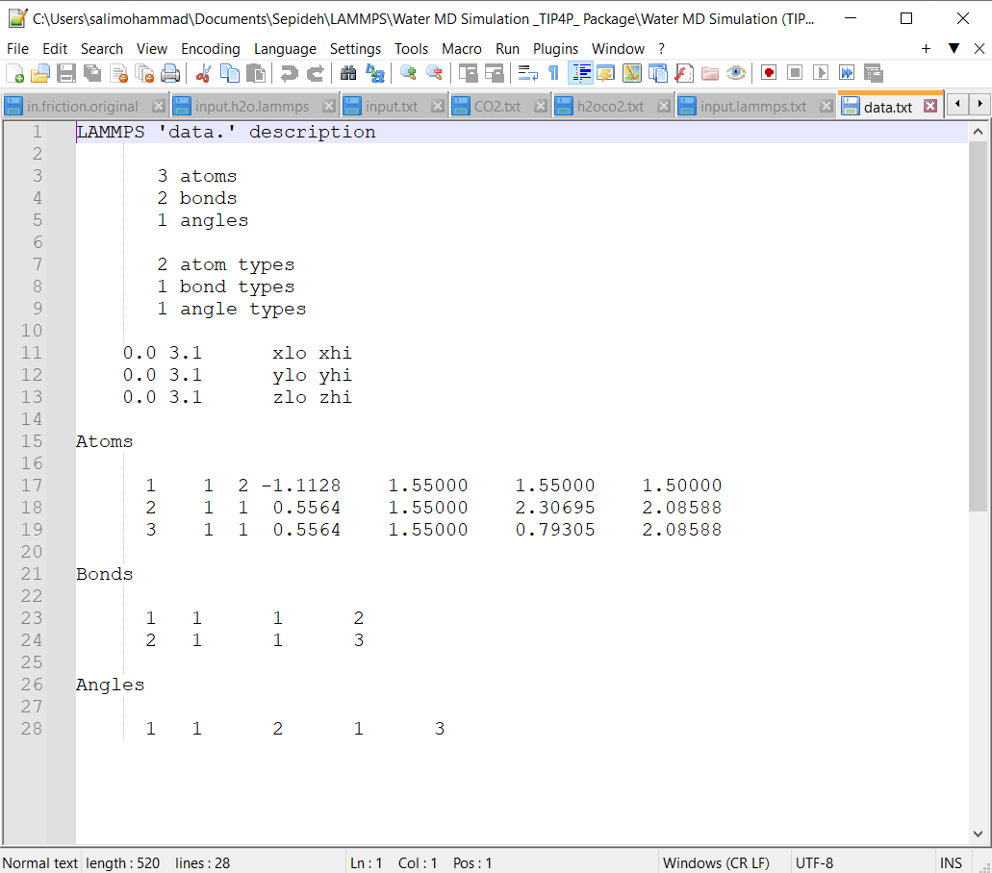
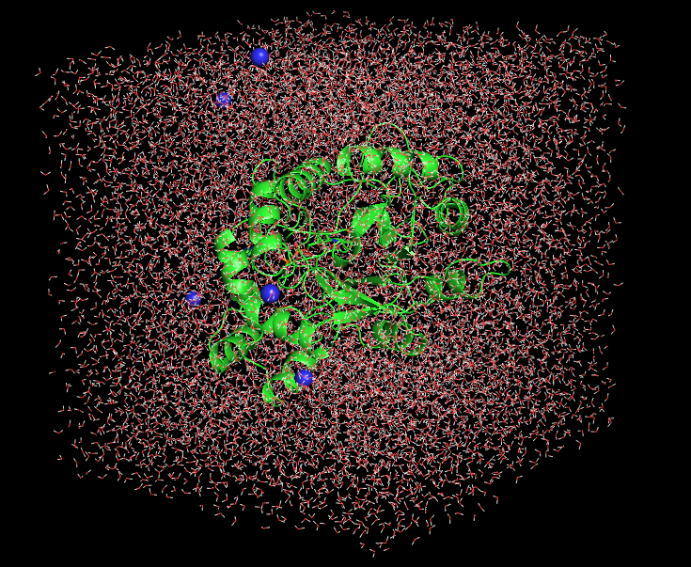
Data Gathering and Molecular Dynamics (MD) Simulation
Molecular Dynamics (MD) Simulation
Definition:
MD simulation is a computational approach used to observe and analyze the behavior of molecules over time.
It provides detailed insights into molecular interactions and properties that influence density.
How it Works:
Simulates the motion and interaction of molecules based on physical laws.
Tracks variables such as temperature (T), pressure (P), and energy to understand their impact on density.
Relevance to Density Modeling:
Generates data on how molecular arrangement and interactions affect density.
Provides a basis for understanding density changes under various conditions.
Data Requisition
Purpose:
To obtain and prepare data essential for modeling carbon density.
Ensure comprehensive and relevant data for accurate machine learning predictions.
Types of Data Collected:
MD Simulation Data:
Temperature (T): Affects molecular motion and density.
Pressure (P): Influences molecular packing and density.
Energy: Includes potential and kinetic energy, impacting density.

Slide 5
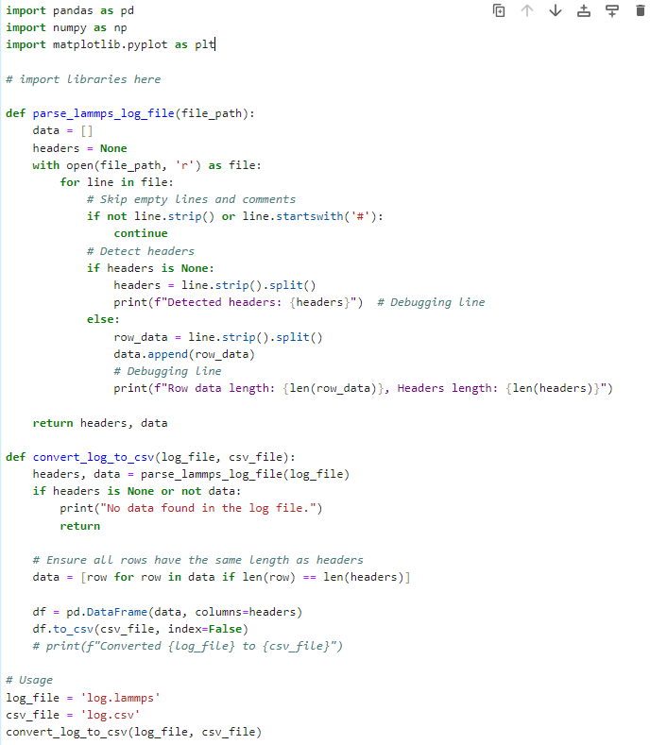
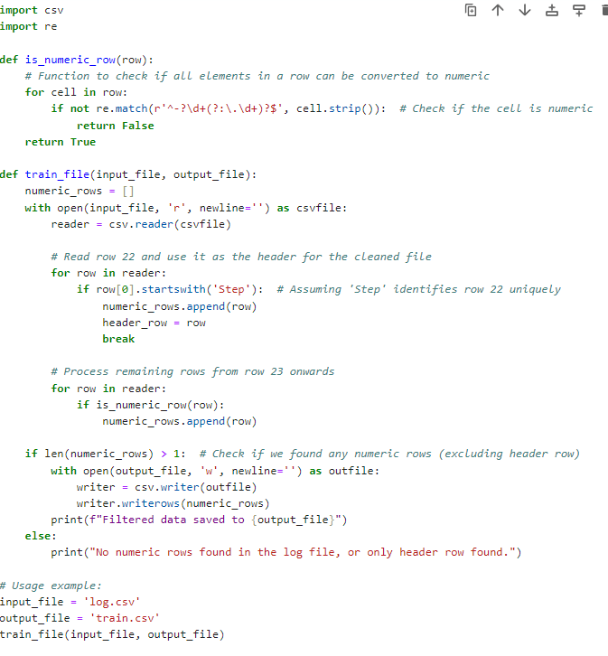
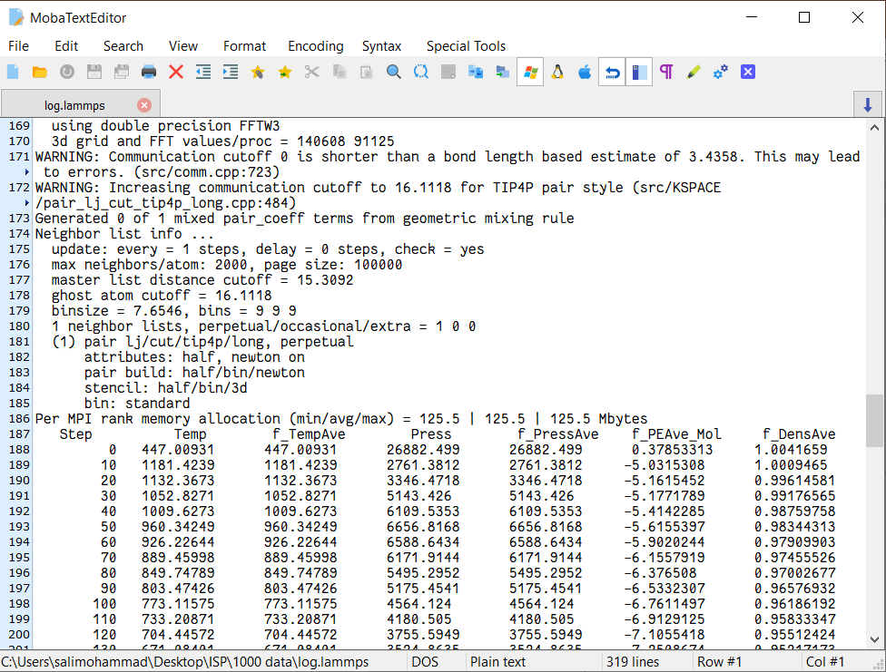
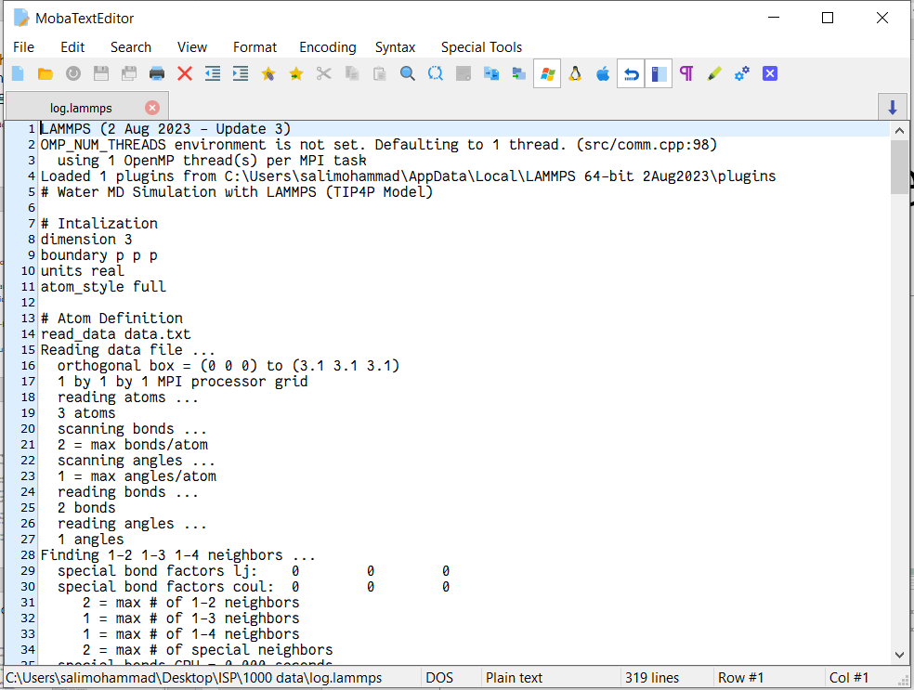
Data Pre-processing and Cleaning

Slide 6
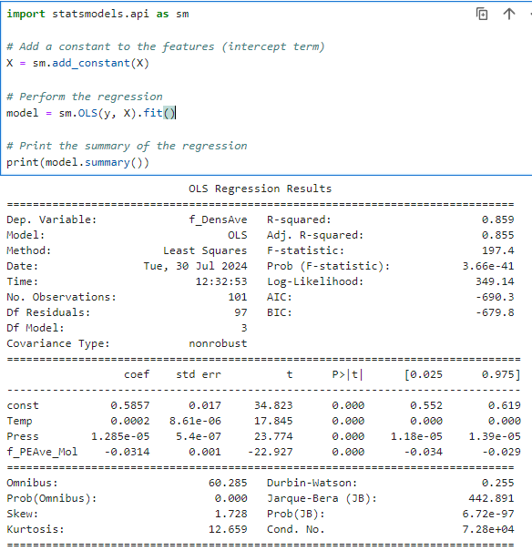
Independent Variable Selection, Significance Test and EDA
OLS Regression Results Overview
R-squared: 0.859
The model explains approximately 85.9% of the variance in the dependent variable (f_DensAve), indicating a strong fit.
Adj. R-squared: 0.855
Adjusted for the number of predictors, it shows the model is robust even with multiple variables.
F-statistic: 197.4 (p < 0.0001)
Indicates the overall significance of the model. The p-value suggests that the model is statistically significant.
Coefficients:
Intercept (const): 0.5857 (p < 0.0001) — Base value of f_DensAve when all predictors are zero.
Temp: 0.0002 (p < 0.0001) — For each unit increase in temperature, f_DensAve increases by 0.0002.
Press: 1.285e-05 (p < 0.0001) — For each unit increase in pressure, f_DensAve increases by 0.00001285.
f_PEAve_Mol: -0.0314 (p < 0.0001) — For each unit increase in f_PEAve_Mol, f_DensAve decreases by 0.0314.
Significance Tests:
All predictors (Temp, Press, f_PEAve_Mol) have p-values < 0.0001, indicating they are significant in predicting f_DensAve.

Slide 7
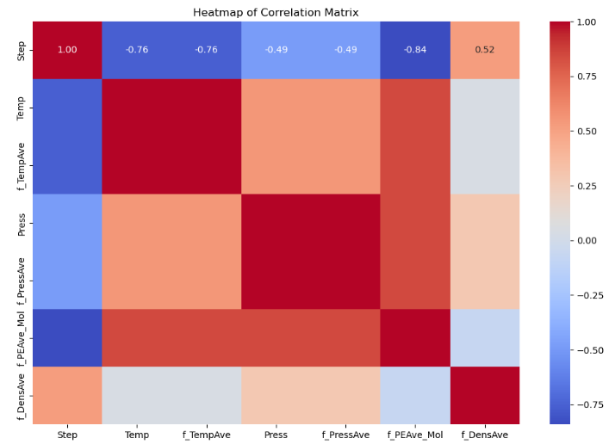
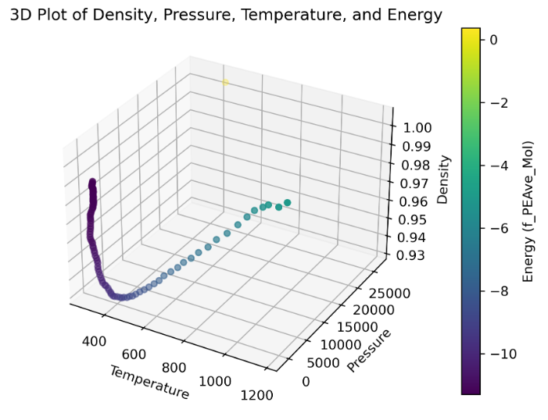
EDA

Slide 8
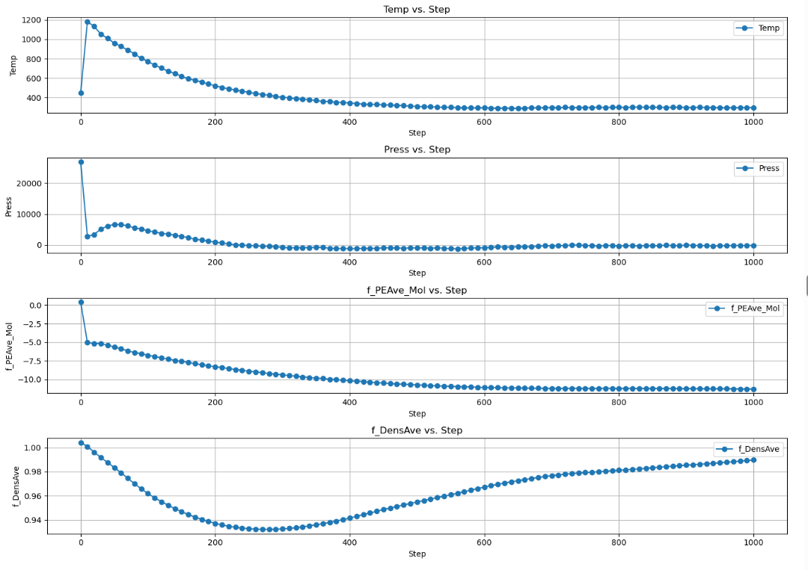
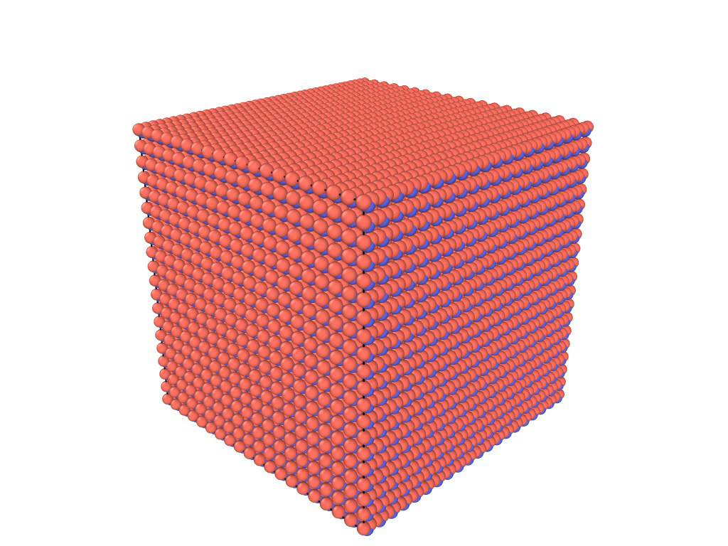
EDA

Slide 9
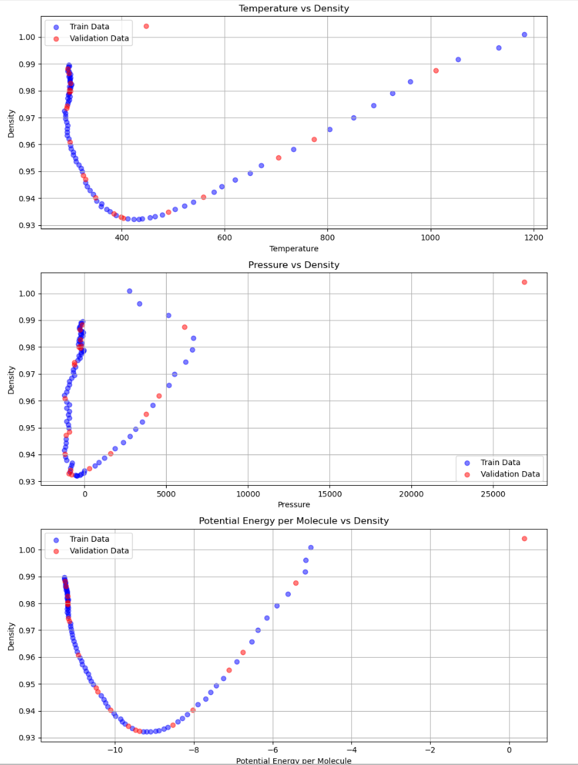
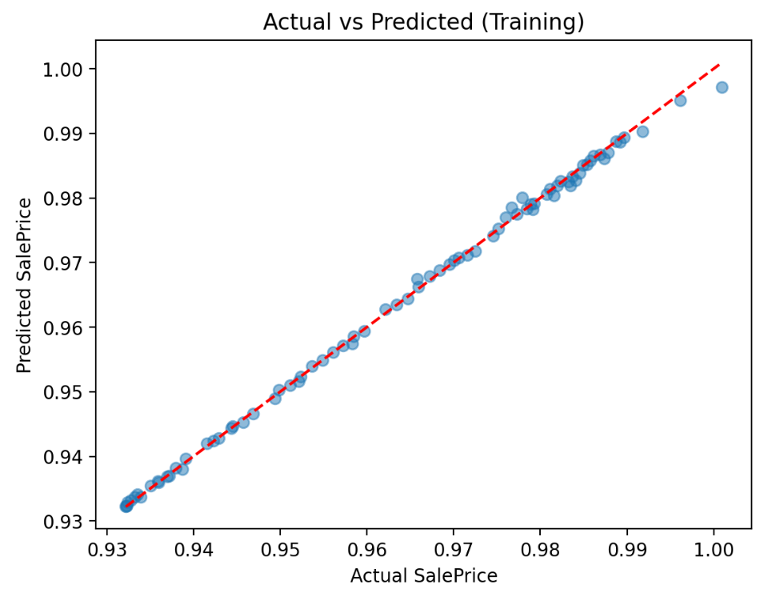
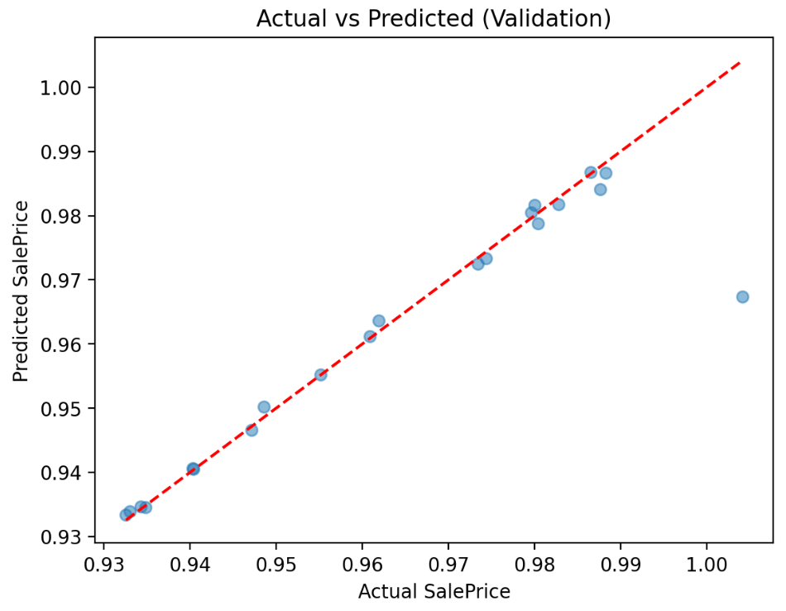
Initial ML Method
ML Steps:
Feature selection
Data splitting
ML: Random Forest Regressor
Validation RMSE: 0.00812
Validation R² Score: 0.861

Slide 10
Hyperparameter Tuning, For-Loop, OPTUNA, PSO
 | For-Loop | OPTUNA | PSO
MSE | 0.00801 | 0.0064 | 0.0080
R² | 0.8649 | 0.8971 | 0.8648

Slide 11
Comparison Between MLs
 | Random Forest | Gradient Boosting | SVR | Linear Regression | Ridge Regression | K-Neighbors Regressor
MSE | 0.0001 | 0.0001 | 0.0005 | 0.003 | 0.0032 | 0.01
R² | 0.87 | 0.83 | -0.024 | -7.0058 | -5.65 | 0.766

Slide 12
Summary, Challenges, and Future Work
Machine Learning (ML) has demonstrated success in predicting thermodynamic properties under conditions that are costly and difficult to measure directly.
When generating data using MD simulations, it is crucial to consider factors such as physical states and molecular coordination to ensure accurate and representative results.
Optuna proved to be an effective tool for hyperparameter tuning in ML models, enhancing the performance of our algorithms.
Among the various ML algorithms tested, Random Forest emerged as the most effective for this modelling task.
Challenges: Understanding and preprocessing the dataset
Future Work: I plan to expand the dataset to include a larger volume of data and additional physical properties. Additionally, I aim to use remote computing resources (e.g., Compute Canada, Siku) for more extensive analyses.

